Slide 1
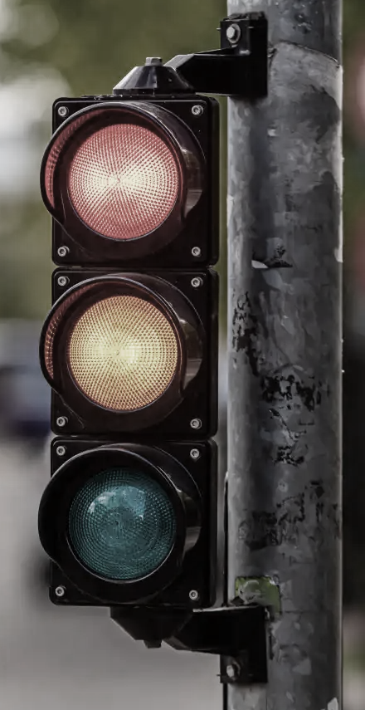
Project title: A Hierarchical Network-Based Method for Predicting Driver Traffic Violations

Slide 2
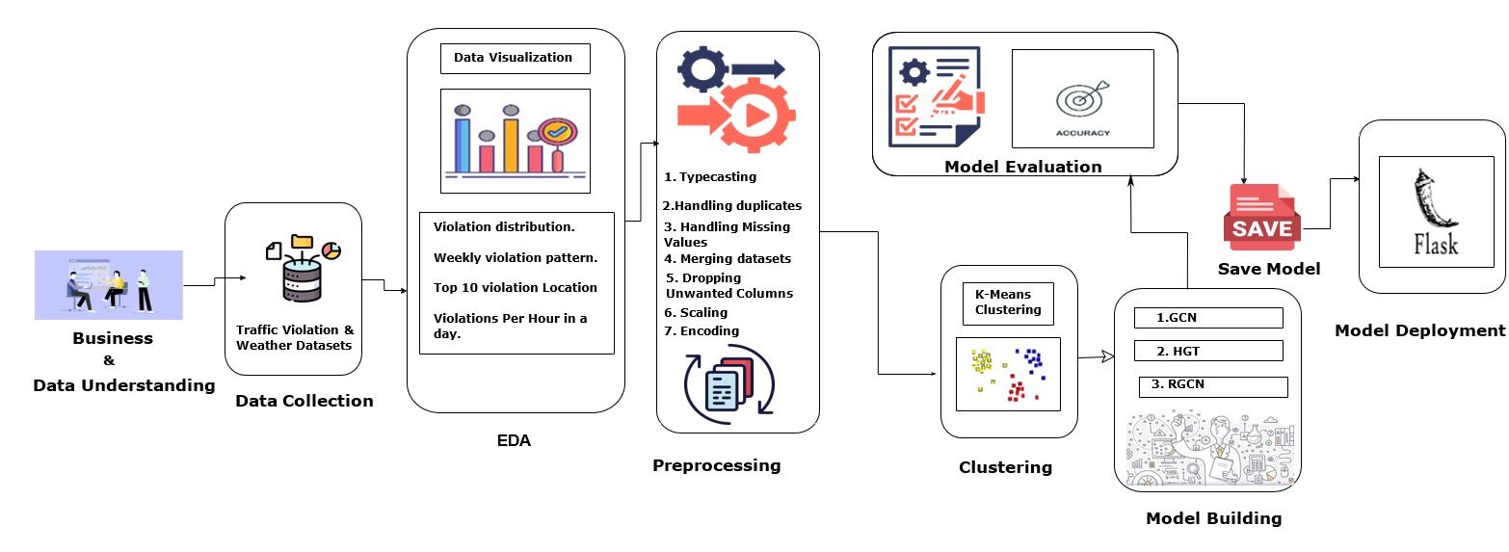
Architecture

Slide 3
Problem Statement:
Cities struggle to prevent traffic violations because they don't know where or when they'll happen. This project uses a network-based model to predict violations in advance so safety teams can act earlier and smarter.
Business Objectives:
Maximize road safety by finding places, times, and driver behaviors that often lead to violations.
Minimize wasted police effort by predicting when and where traffic rules are most likely to be broken.
Maximize awareness of how weather affects traffic violations to help plan safety measures in bad weather.
Business Constraints:
Minimize wrong predictions to avoid unnecessary police checks.
Minimize the time and cost needed to run the model.

Slide 4
Business Success Criteria:
Reduce police response time to high-risk areas by at least 40%.
Improve detection of traffic violation hotspots by 30% compared to current methods.
Economic Success Criteria:
Save on patrol fuel and manpower by using data-driven deployment plans.
Achieve measurable safety and cost benefits from the model within 6–12 months of use.
Machine Learning Success Criteria:
Model should reach at least 85% accuracy in predicting traffic violations.
Show a strong link between weather and violations (correlation ≥ 0.7).

Slide 5
Datasets
1. Maryland Traffic Violations Dataset
Shape: 309,025 rows × 43 columns
Description: Real-world traffic stop records from Maryland.
Key Features:
Driver Info: Race, Gender, City, State, License State
Vehicle Info: Make, Model, Year, Type, Color
Violation Info: Type, Charge, Article, Arrest Type, Contributed to Accident
Location Info: Street, Latitude, Longitude, Geolocation
Stop Info: Date, Time, Accident Flag, Search Conducted, Search Outcome
2. Weather Data
Shape: 11,109 rows × 12 columns
Description: Daily weather data aligned with traffic stops.
Key Features:
Temperature, Snow, Wind, Precipitation, Pressure.

Slide 6
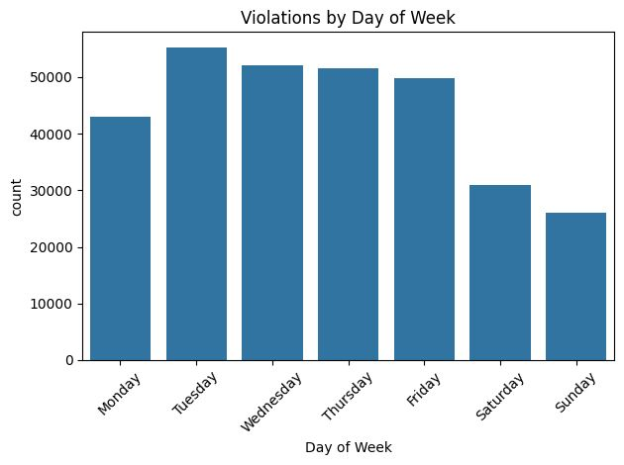
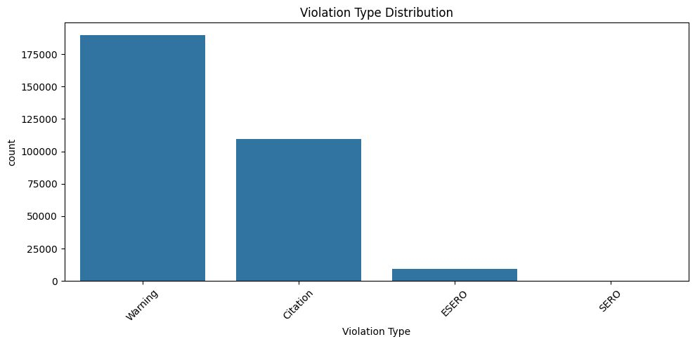
EDA – Exploratory Data Analysis

Slide 7
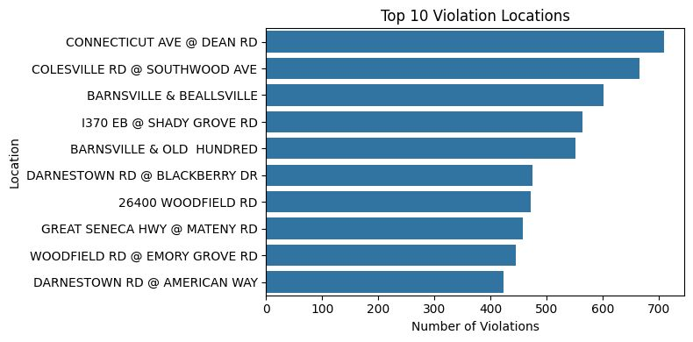
Top 10 Violation Locations:

Slide 8
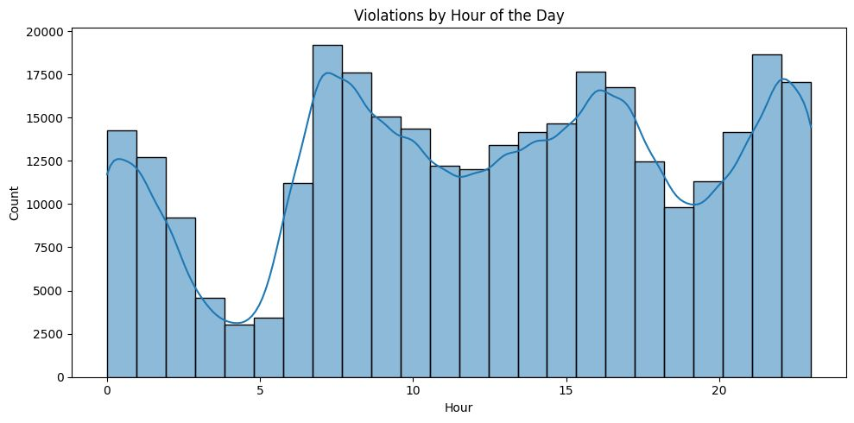
Violations Per Hour in a Day

Slide 9
Data Pre-processing
Step 1: Date Conversion
Converted the ‘Date Of Stop’ field to datetime format, handling invalid or inconsistent entries gracefully.
Extracted date only (removing time details) and the year from the datetime for better temporal analysis.
Step 2: Violation Type Cleaning
Initial data showed mostly three types of violations: Warning, Citation, and ESERO, with a very small number of SERO entries (only 3).
Merged the rare ‘SERO’ entries into ‘ESERO’ to consolidate categories and improve data consistency.
Step 3: Type Conversion
Numerical Conversion
Converted latitude and longitude columns to numeric types to enable geographic calculations and mapping.
Boolean Conversion
Converted multiple columns representing true/false flags (e.g., Accident, Alcohol, Fatal) into boolean data types for efficient storage
Categorical Conversion
Converted many textual columns (like Agency, Vehicle Type, Violation Type, Driver demographics) to categorical data types.

Slide 10
Handling Duplicates
Traffic Dataset
Identified and removed 274 duplicate rows.
Updated shape: 308,751 rows × 44 columns.
Weather Dataset
No duplicate rows detected.
Result: Cleaned datasets with unique entries, reducing redundancy and improving data integrity for analysis and modelling.
Missing Value Imputation – Traffic Dataset
Column | Missing Count | Action Taken
Description | 1 | Filled using Charge → Description mapping
Location | 2 | Filled using SubAgency → most common Location
Article | 9562 | Replaced '00' with 'BR', missing filled as 'No Article'
Driver City | 108 | Filled using mode City per Driver State (Cramér's V = 0.89)
Make | 8 | Imputed by most common Make per VehicleType
Model | 15 | Filled by most common Model per Make, fallback to global mode
Color | 2605 | Filled by most common Color per Model, fallback to most frequent

Slide 11
Geolocation Imputation (Latitude & Longitude): 26,840 invalid (0,0) entries Strategy: Hierarchical — Location + SubAgency → Location → Agency median Result: All zero coordinates corrected Success Rate: 100% (26,840 records imputed)
Weather Data Cleaning: Dropped columns with high missingness: 'wpgt', 'tsun' Final Shape: 11,109 rows × 11 columns Remaining Columns: Temperature, Precipitation, Wind, Pressure, SubAgency, Date
Weather Data Imputation • Dropped high-missing columns; imputed snow using seasonal rules and precipitation logic • Capped extreme outliers in prcp using IQR-based Winsorization • Retained pres and wspd as-is (within realistic ranges); merged with traffic data on Date + SubAgency

Slide 12
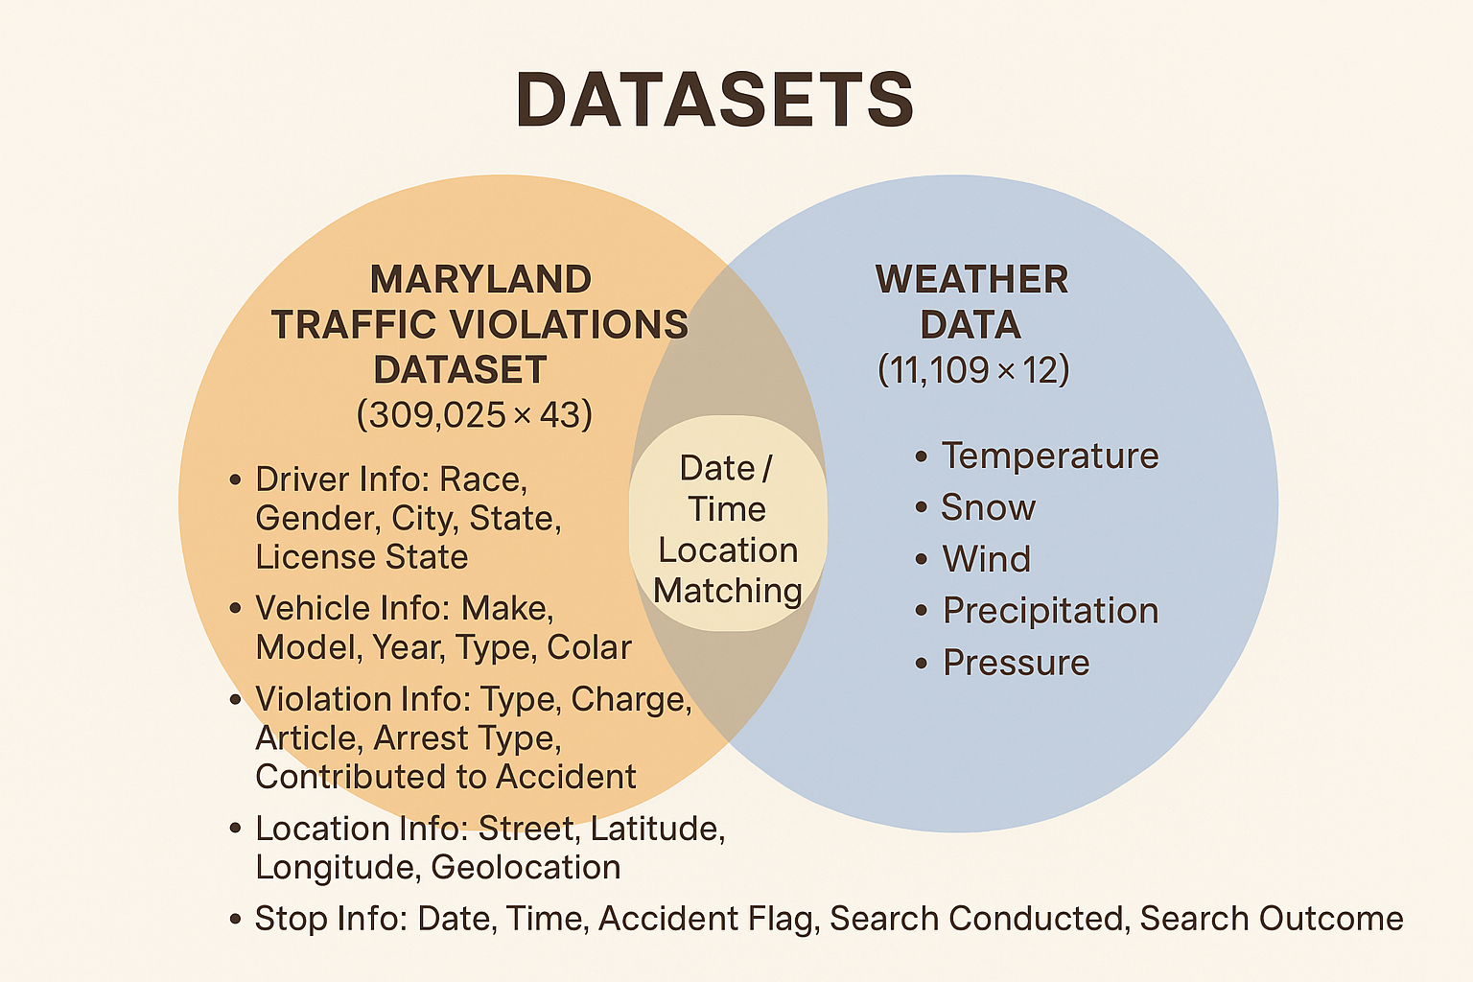
Merging Traffic & Weather Data

Slide 13
K-Means Clustering for Traffic Pattern Discovery
Purpose: To uncover hidden patterns in traffic, stop incidents by grouping similar cases based on time, location, vehicle, weather, and violation characteristics.
Why Clustering? ➤ Identify hotspots and common conditions under which certain types of violations or accidents occur. ➤ Helps law enforcement and policy makers optimize resource allocation, patrol strategies, and public safety interventions.
Final number of clusters (k): 25
Explored values: k = 4, 8, 14, 25, 55
Chosen 25 using Elbow Method & Silhouette Score
Features Used (23 Total)
Location & Time: subagency, Hour, day_of_week, month_x
Vehicle Info: vehicletype, make, model, year_x, color
Weather Data: tavg, prcp, snow,wdir, wspd, pres. Incident Info:accident, belts, personal_injury, property_damage, fatal, alcohol, commercial_vehicle, work_zone

Slide 14
Graph Construction Using k-NN
Objective: To model relationships between traffic stop data points by constructing a graph structure using K-Nearest Neighbors (k-NN).
Method Used: ➤ knn_graph() from PyTorch Geometric to create the edge_index (graph connectivity). ➤ Each node connects to its k nearest neighbors in the feature space.
Tried Values:
k = 3 5,7,9,12
Proceeded with k = 12 for better connectivity and local context.
Resulting edge_index:
Shape: torch.Size([2, 1,554,917])
Represents ~1.55 million edges in the graph.

Slide 15
Why not Regular Classification model ?
In a standard classification setup (e.g., using Random Forest, SVM, XGBoost), you treat each data row independently.
Limitations:
No way to know if two violations are related (e.g., same time and place).
No insight into how violations spread (e.g., more likely to happen near hotspot areas).
No structure or interaction is modeled (hierarchies, influence, etc.).
Why Use Network Analysis Instead?
Traffic violations are not isolated events — they’re often interconnected:
One driver might commit multiple violations.
Some locations have patterns of high violation rates.
Certain times of day/weather conditions increase violations in clusters.
One violation may influence others in nearby locations.
These patterns can be modeled as a graph or network, where:
Nodes = Drivers, Locations, Time Bins, etc.
Edges = Relationships like “same driver violated at different places”, or “two locations share violation patterns”.
Hierarchy = District → Subdistrict → Intersection level.

Slide 16
Model
Relational Graph Convolutional Network (RGCN)
Why RGCN?
Traffic stop data contains relational patterns (e.g., vehicle, time, location, conditions).
RGCN supports multiple edge types — suitable for complex structured data.
Outperformed GCN and GAT in our case.
Model Architecture:
2-layer RGCN
Hidden dimension: 64
Loss function: Cross Entropy
Optimizer: Adam (lr=0.01)
Training Details
Tried different epochs: 101, 151, 251, 301
Final Test Accuracy: ~72%

Slide 17
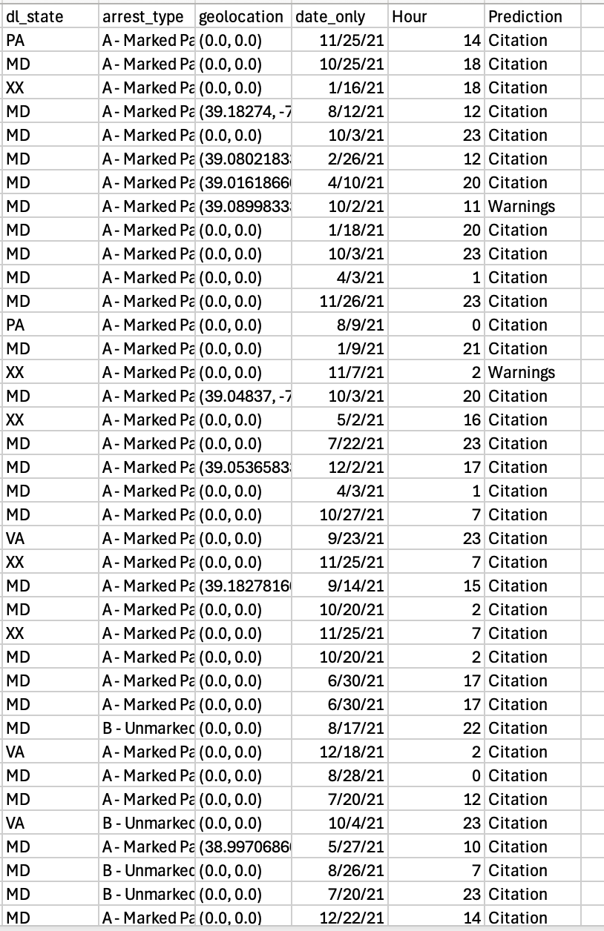
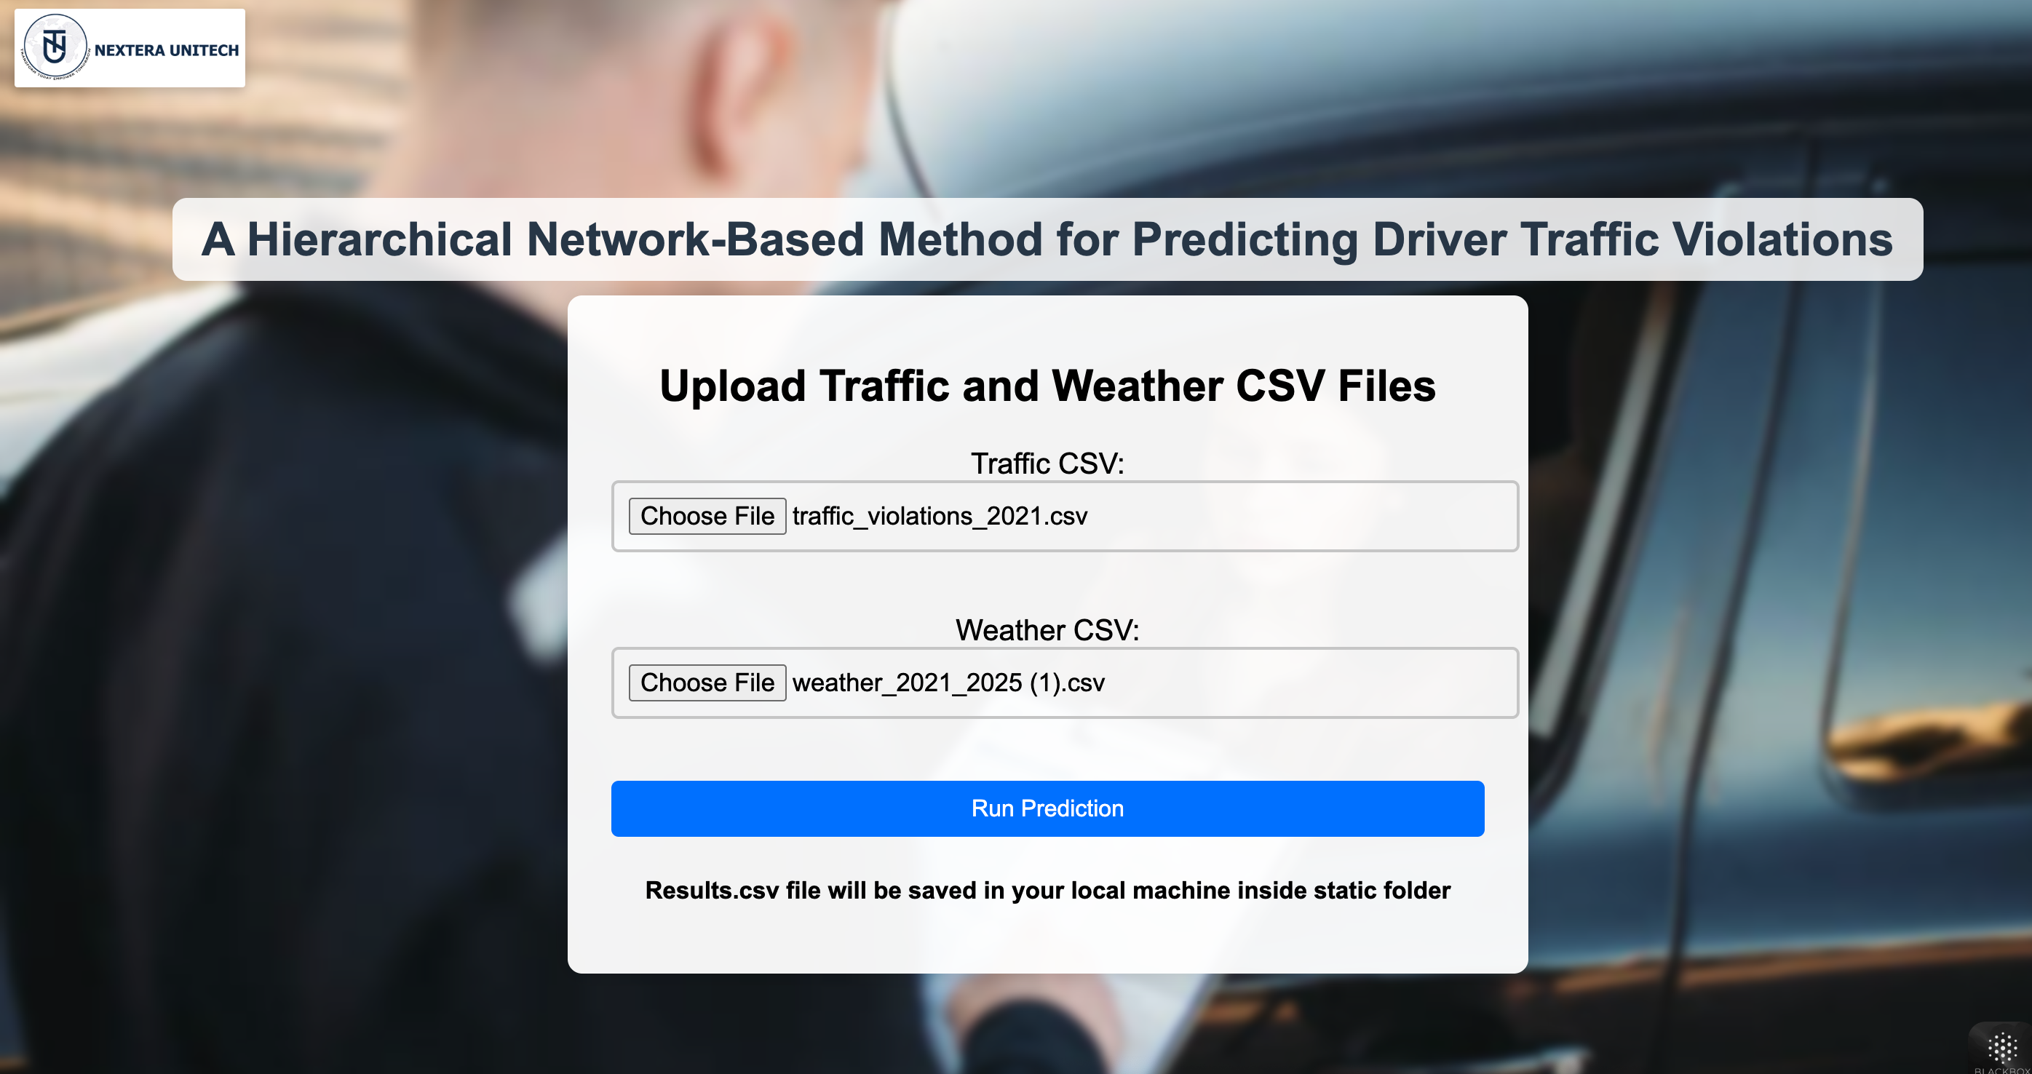
Deployment

